Slide 1
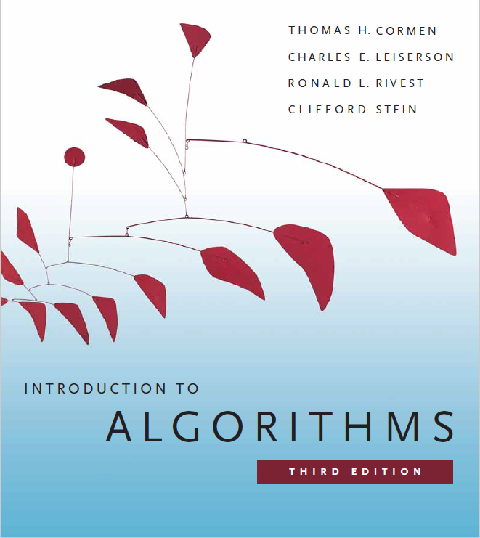
Polynomials and the FFT
Prepared by Shmuel Wimer
Courtesy of Prof. Dror Rawitz

Slide 2
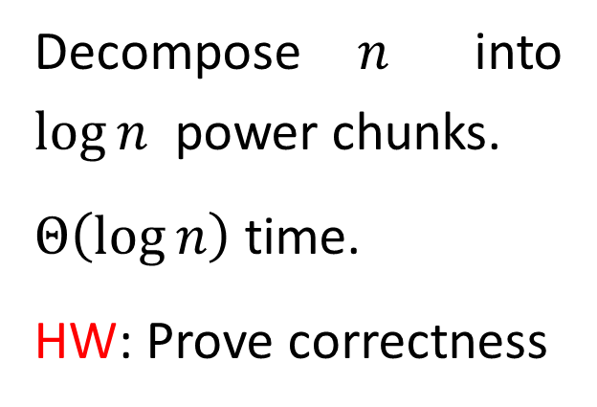
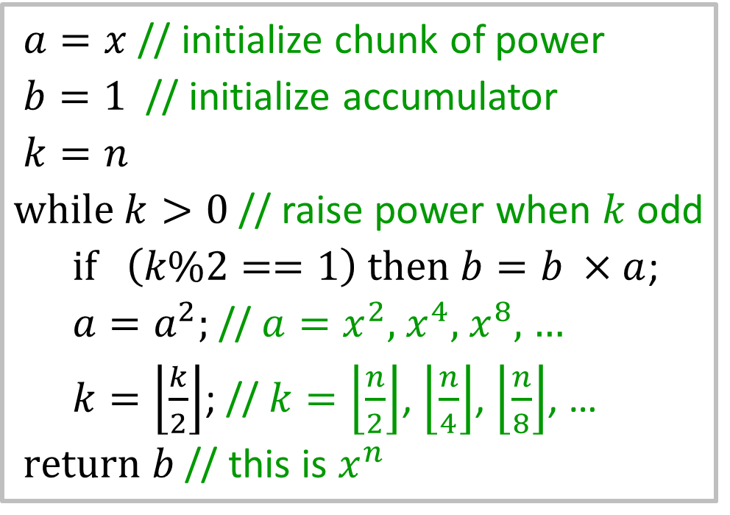
Power $x^{n}$
Straight forward calculation takes $Θ\left(n\right)$ time. Better is possible.
$a=x$ // initialize chunk of power
$b=1$ // initialize accumulator
$k=n$
$\text{while} k>0$ // raise power when $k$odd
$\text{if} \left(k\%2==1\right) then b=b ×a$;
$a=a^{2}$; // $a=x^{2}$, $x^{4}$, $x^{8}$, …
$k=\left\lfloor \frac{k}{2}\right\rfloor$; // $k=\left\lfloor \frac{n}{2}\right\rfloor$, $\left\lfloor \frac{n}{4}\right\rfloor$, $\left\lfloor \frac{n}{8}\right\rfloor$, …
$\text{return} b$ // this is $x^{n}$
Decompose $n$ into $\log{n}$ power chunks.
$Θ\left(\log{n}\right)$ time.
HW: Prove correctness

Slide 3
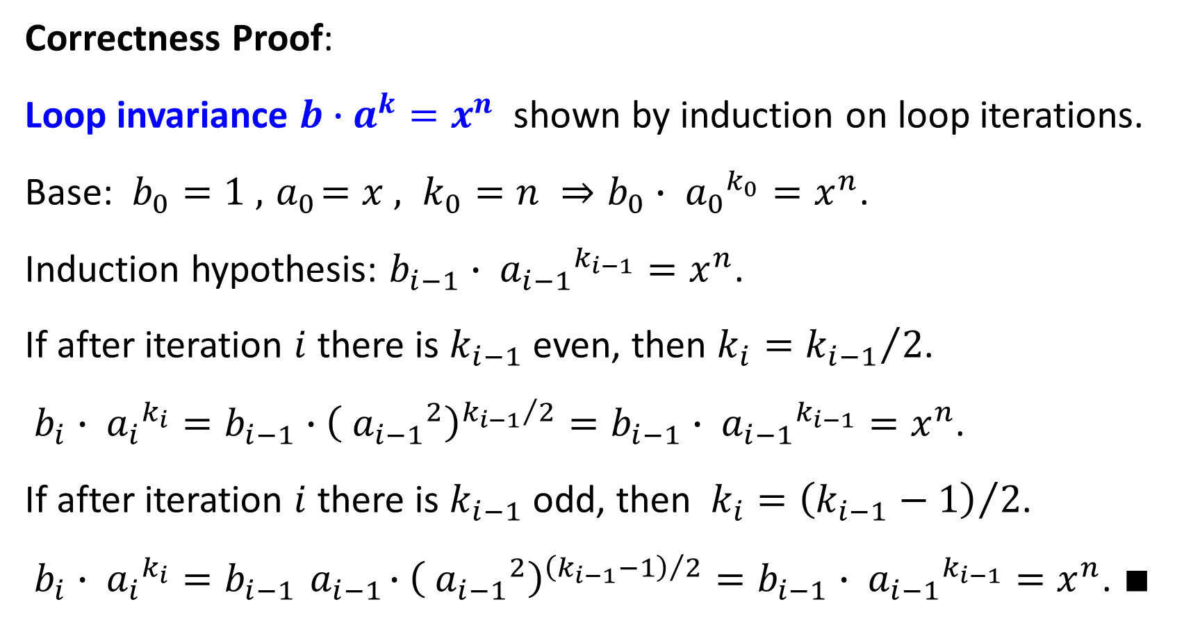
Correctness Proof:
Loop invariance $b∙a^{k}=x^{n}$ shown by induction on loop iterations.
Base: $b_{0}=1 , { a}_{0}=x , k_{0}=n ⇒b_{0}∙{{ a}_{0}}^{k_{0}}=x^{n}$.
Induction hypothesis: $b_{i−1}∙{{ a}_{i−1}}^{k_{i−1}}=x^{n}$.
If after iteration $i$ there is $k_{i−1}$ even, then $k_{i}={k_{i−1}}/2$.
$b_{i}∙{{ a}_{i}}^{k_{i}}=b_{i−1}∙{\left({{ a}_{i−1}}^{2}\right)}^{{k_{i−1}}/2}=b_{i−1}∙{{ a}_{i−1}}^{k_{i−1}}=x^{n}$.
If after iteration $i$ there is $k_{i−1}$ odd, then $k_{i}={\left(k_{i−1}−1\right)}/2$.
$b_{i}∙{{ a}_{i}}^{k_{i}}=b_{i−1}{ a}_{i−1}∙{\left({{ a}_{i−1}}^{2}\right)}^{{\left(k_{i−1}−1\right)}/2}=b_{i−1}∙{{ a}_{i−1}}^{k_{i−1}}=x^{n}$. $∎$

Slide 4
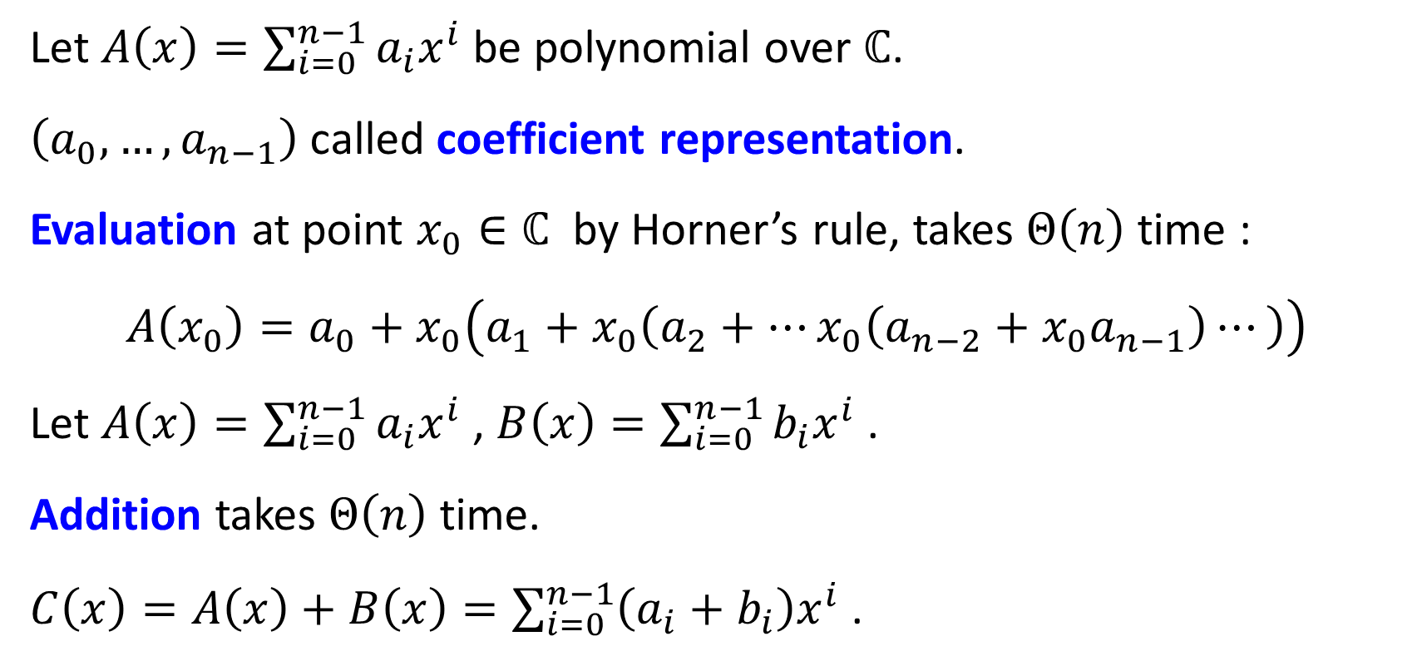
Polynomials
Let $A\left(x\right)=\sum_{i=0}^{n−1}{a_{i}x^{i}}$ be polynomial over $ℂ$.
$\left(a_{0},…,a_{n−1}\right)$ called coefficient representation.
Evaluation at point $x_{0}∈ℂ$ by Horner’s rule, takes $Θ\left(n\right)$ time :
$$A\left(x_{0}\right)=a_{0}+x_{0}\left(a_{1}+x_{0}\left(a_{2}+…x_{0}\left(a_{n−2}+x_{0}a_{n−1}\right)⋯\right)\right)$$
Let $A\left(x\right)=\sum_{i=0}^{n−1}{a_{i}x^{i}}$ , $B\left(x\right)=\sum_{i=0}^{n−1}{b_{i}x^{i}}$ .
Addition takes $Θ\left(n\right)$ time.
$C\left(x\right)=A\left(x\right)+B\left(x\right)=\sum_{i=0}^{n−1}{\left(a_{i}+b_{i}\right)x^{i}}$ .

Slide 5
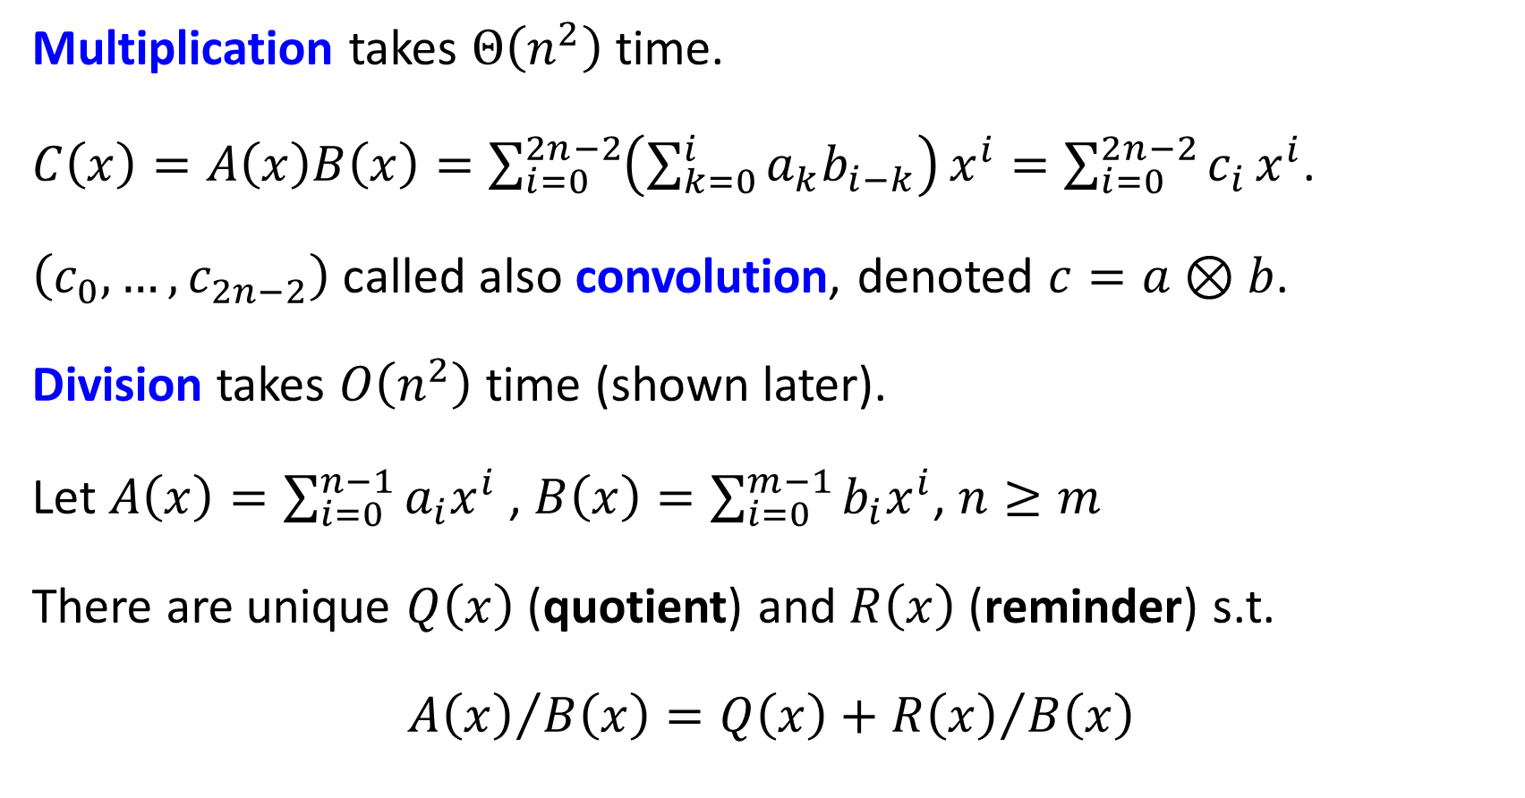
Multiplication takes $Θ\left(n^{2}\right)$ time.
$C\left(x\right)=A\left(x\right)B\left(x\right)=\sum_{i=0}^{2n−2}{\left(\sum_{k=0}^{i}{a_{k}b_{i−k}}\right)}x^{i}=\sum_{i=0}^{2n−2}{c_{i}}x^{i}$.
$\left(c_{0},…,c_{2n−2}\right)$ called also convolution, denoted $c=a⊗b$.
Division takes $O\left(n^{2}\right)$ time (shown later).
Let $A\left(x\right)=\sum_{i=0}^{n−1}{a_{i}x^{i}}$ , $B\left(x\right)=\sum_{i=0}^{m−1}{b_{i}x^{i}}$, $n≥m$
There are unique $Q\left(x\right)$ (quotient) and $R\left(x\right)$ (reminder) s.t.
$${A\left(x\right)}/{B\left(x\right)}=Q\left(x\right)+{R\left(x\right)}/{B\left(x\right)}$$

Slide 6

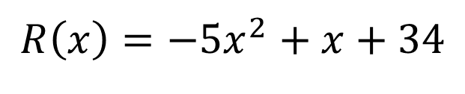
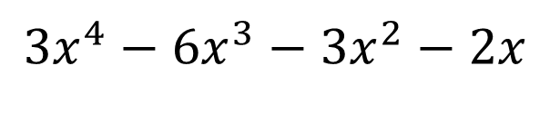
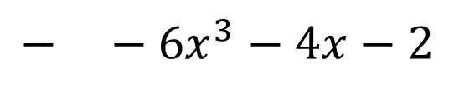



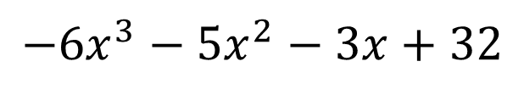


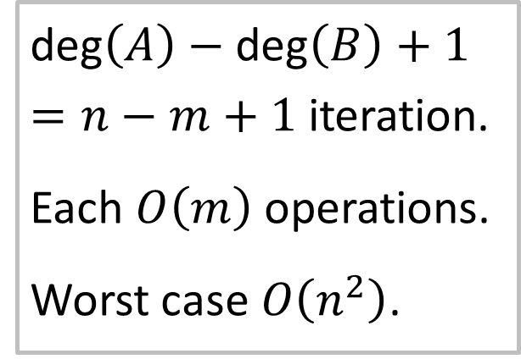
Example: $A\left(x\right)=9x^{5}+3x^{4}−2x+32$ , $B\left(x\right)=3x^{3}+2x+1$
$$Q\left(x\right)= 3x^{2}$$
$$+ x$$
$$− 2$$
$9x^{5}+3x^{4}−2x+32$ $3x^{3}+2x+1$
$−$ $9x^{5}+6x^{3}+3x^{2}$
$\text{deg}\left(A\right)−\text{deg}\left(B\right)+1=n−m+1$ iteration.
Each $O\left(m\right)$ operations.
Worst case $O\left(n^{2}\right)$.
$$3x^{4}−6x^{3}−3x^{2}−2x$$
$−$ $3x^{4}+2x^{2}+x$
$$−6x^{3}−5x^{2}−3x+32$$
$$− −6x^{3}−4x−2$$
$$R\left(x\right)=−5x^{2}+x+34$$

Slide 7
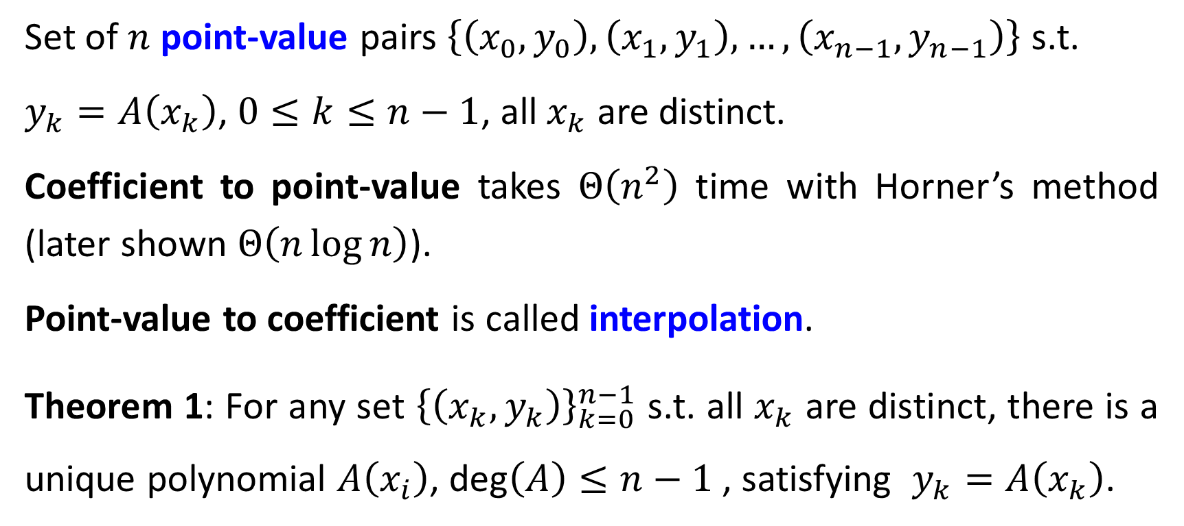
Point-Value Representation
Set of $n$ point-value pairs $\left\{\left(x_{0},y_{0}\right),\left(x_{1},y_{1}\right),…,\left(x_{n−1},y_{n−1}\right)\right\}$ s.t.
$y_{k}=A\left(x_{k}\right)$, $0≤k≤n−1$, all $x_{k}$ are distinct.
Coefficient to point-value takes $Θ\left(n^{2}\right)$ time with Horner’s method (later shown $Θ\left(n\log{n}\right)$).
Point-value to coefficient is called interpolation.
Theorem 1: For any set ${\left\{\left(x_{k},y_{k}\right)\right\}}_{k=0}^{n−1}$ s.t. all $x_{k}$ are distinct, there is a unique polynomial $A\left(x_{i}\right)$, $\text{deg}\left(A\right)≤n−1$ , satisfying $y_{k}=A\left(x_{k}\right)$.

Slide 8
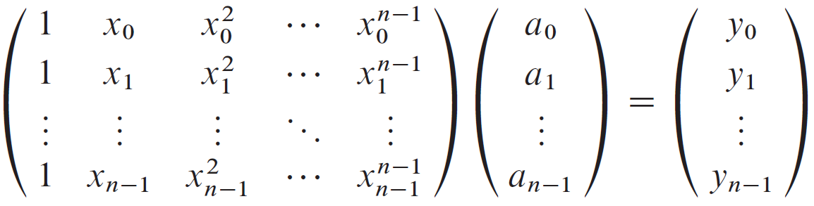

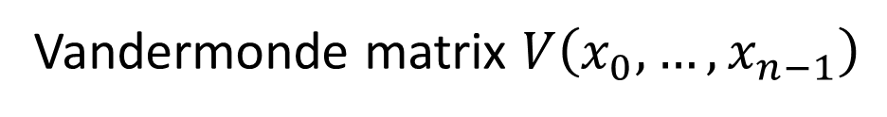
Proof: Point-value matrix representation implies $n$ equation of $n$ unknown coefficients $\left(a_{0},…,a_{n−1}\right)$.
$det \left(V\right)=\prod_{1≤k<j≤n}{\left(x_{k}−x_{j}\right)≠0}$, ⇒ $a=V^{−1}\left(x_{0},…,x_{n−1}\right)y$. $∎$
Vandermonde matrix $V\left(x_{0},…,x_{n−1}\right)$

Slide 9
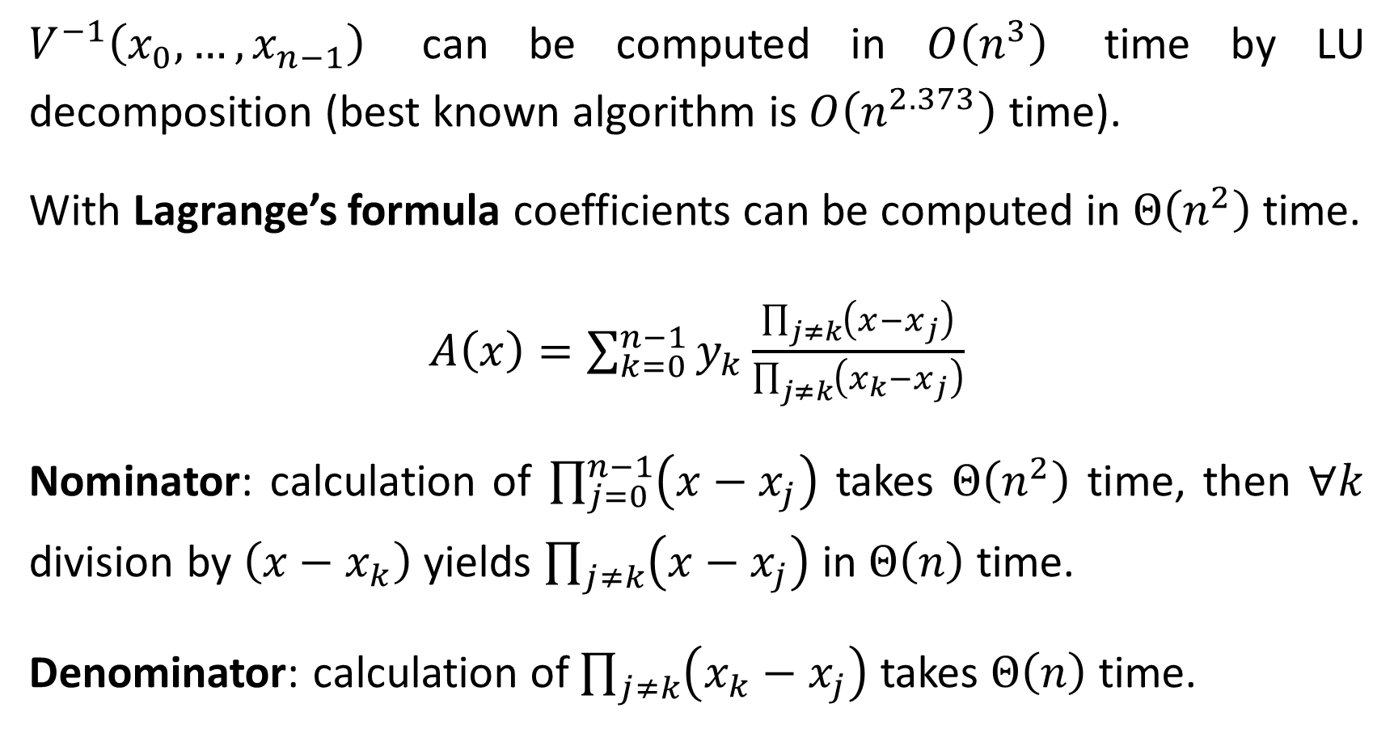
$V^{−1}\left(x_{0},…,x_{n−1}\right)$ can be computed in $O\left(n^{3}\right)$ time by LU decomposition (best known algorithm is $O\left(n^{2.373}\right)$ time).
With Lagrange’s formula coefficients can be computed in $Θ\left(n^{2}\right)$ time.
$A\left(x\right)=\sum_{k=0}^{n−1}{y_{k}\frac{\prod_{j≠k}{\left(x−x_{j}\right)}}{\prod_{j≠k}{\left(x_{k}−x_{j}\right)}}}$
Nominator: calculation of $\prod_{j=0}^{n−1}{\left(x−x_{j}\right)}$ takes $Θ\left(n^{2}\right)$ time, then $∀k$ division by $\left(x−x_{k}\right)$ yields $\prod_{j≠k}{\left(x−x_{j}\right)}$ in $Θ\left(n\right)$ time.
Denominator: calculation of $\prod_{j≠k}{\left(x_{k}−x_{j}\right)}$ takes $Θ\left(n\right)$ time.

Slide 10
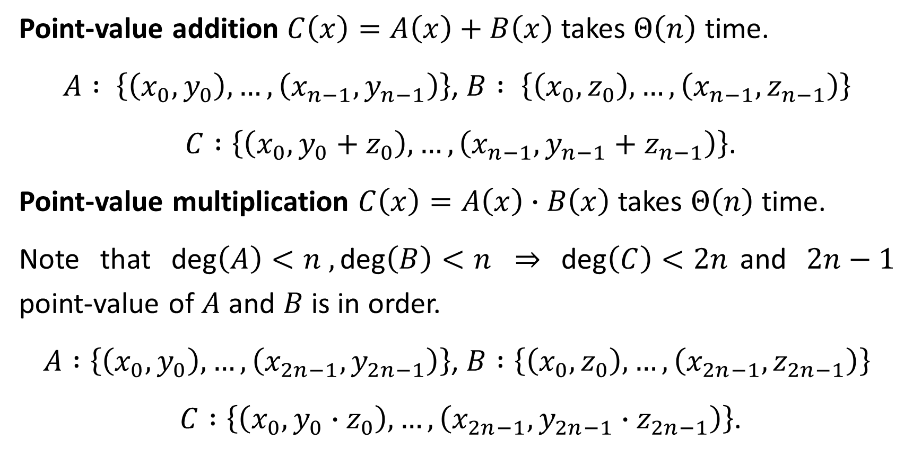
Point-value addition $C\left(x\right)=A\left(x\right)+B\left(x\right)$ takes $Θ\left(n\right)$ time.
$A : \left\{\left(x_{0}, y_{0}\right),…,\left(x_{n−1}, y_{n−1}\right)\right\}$, $B : \left\{\left(x_{0}, z_{0}\right),…,\left(x_{n−1}, z_{n−1}\right)\right\}$
$C :\left\{\left(x_{0}, y_{0}+z_{0}\right),…,\left(x_{n−1}, y_{n−1}+z_{n−1}\right)\right\}$.
Point-value multiplication $C\left(x\right)=A\left(x\right)∙B\left(x\right)$ takes $Θ\left(n\right)$ time.
Note that $\text{deg}\left(A\right)<n , \text{deg}\left(B\right)<n$ ⇒ $\text{deg}\left(C\right)<2n$and $2n−1$ point-value of $A$ and $B$ is in order.
$A :\left\{\left(x_{0}, y_{0}\right),…,\left(x_{2n−1}, y_{2n−1}\right)\right\}$, $B :\left\{\left(x_{0}, z_{0}\right),…,\left(x_{2n−1}, z_{2n−1}\right)\right\}$
$C :\left\{\left(x_{0}, y_{0}∙z_{0}\right),…,\left(x_{2n−1}, y_{2n−1}∙z_{2n−1}\right)\right\}$.

Slide 11
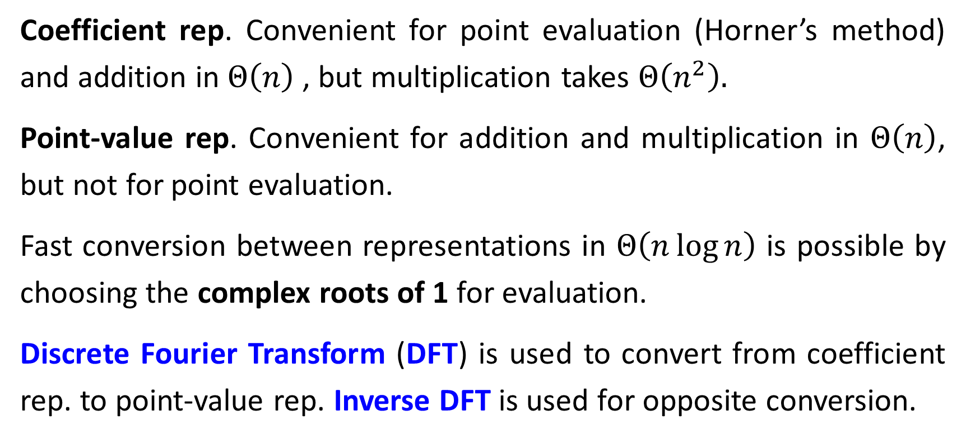
Fast Polynomial Multiplication
Coefficient rep. Convenient for point evaluation (Horner’s method) and addition in $Θ\left(n\right)$ , but multiplication takes $Θ\left(n^{2}\right).$
Point-value rep. Convenient for addition and multiplication in $Θ\left(n\right)$, but not for point evaluation.
Fast conversion between representations in $Θ\left(n\log{n}\right)$ is possible by choosing the complex roots of 1 for evaluation.
Discrete Fourier Transform (DFT) is used to convert from coefficient rep. to point-value rep. Inverse DFT is used for opposite conversion.

Slide 12
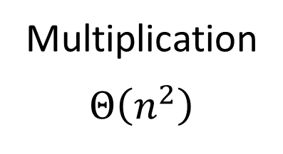

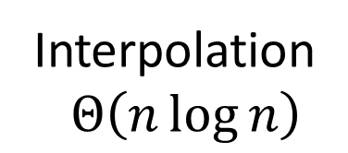



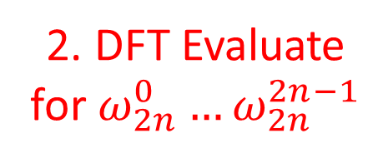
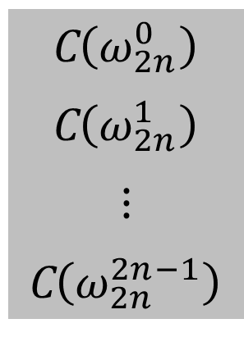

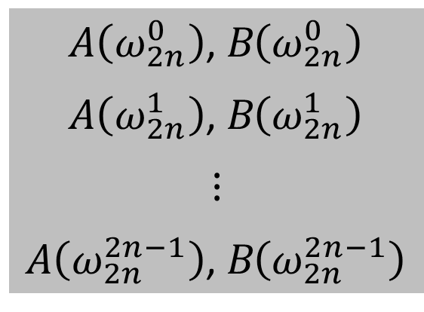
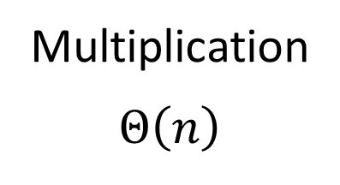
1. Pad $n…2n−1$ by $0$ coefficients
Pad $n…2n−1$ by $0$ coefficients
Coefficient
representation
$$\left(a_{0},a_{1},…,a_{n−1}\right)$$
$$\left(b_{0},b_{1},…,b_{n−1}\right)$$
Multiplication
$$Θ\left(n^{2}\right)$$
$$\left(c_{0},c_{1},…,c_{2n−1}\right)$$
2. DFT Evaluate for $ω_{2n}^{0}…ω_{2n}^{2n−1}$
Evaluation
$$Θ\left(n\log{n}\right)$$
Interpolation
$Θ\left(n\log{n}\right)$
4. Evaluate
Inverse DFT
A$\left(ω_{2n}^{0}\right)$, B$\left(ω_{2n}^{0}\right)$
A$\left(ω_{2n}^{1}\right)$, B$\left(ω_{2n}^{1}\right)$
$$⋮$$
A$\left(ω_{2n}^{2n−1}\right)$, B$\left(ω_{2n}^{2n−1}\right)$
C$\left(ω_{2n}^{0}\right)$
C$\left(ω_{2n}^{1}\right)$
$$⋮$$
C$\left(ω_{2n}^{2n−1}\right)$
Multiplication
$$Θ\left(n\right)$$
Point-value
representation
3. Multiply

Slide 13
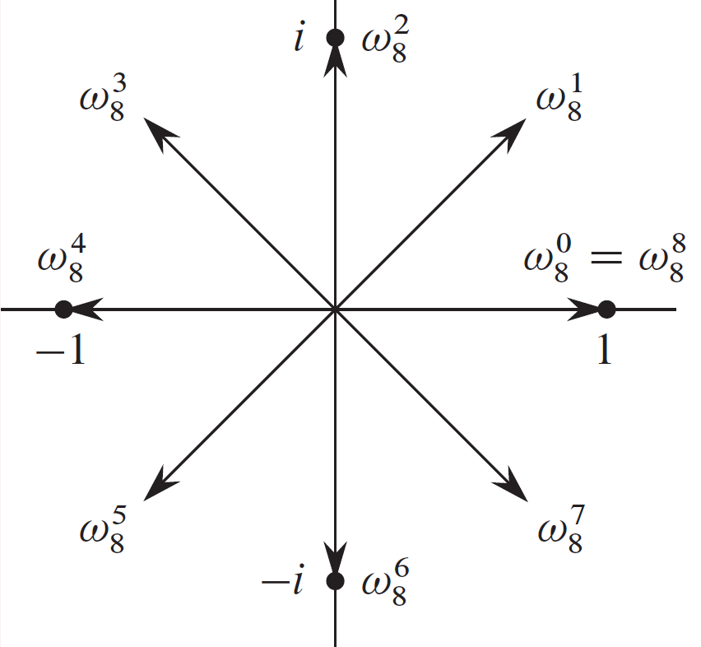
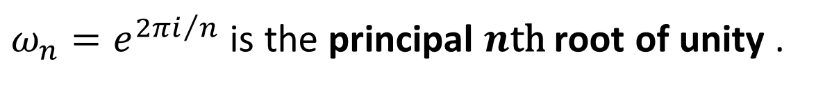
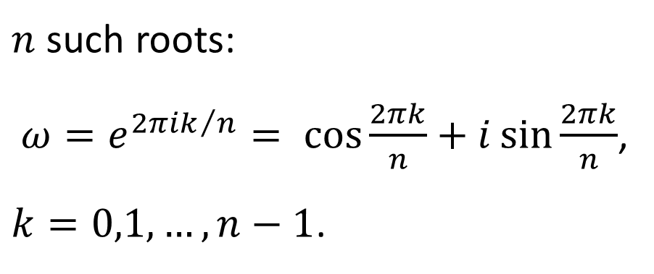
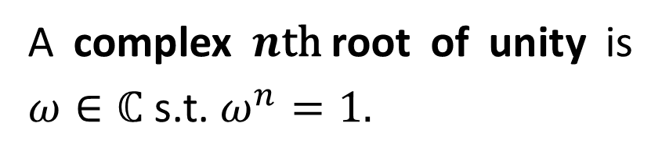
Complex roots of 1
A complex $n\text{th}$root of unity is $ω∈ℂ$ s.t. $ω^{n}=1.$
$n$ such roots:
$ω=e^{{2πik}/n}= \cos{\frac{2πk}{n}}+i\sin{\frac{2πk}{n}}$,
$k=0,1,…,n−1$.
$ω_{n}=e^{{2πi}/n}$ is the principal $n\text{th}$root of unity .

Slide 14
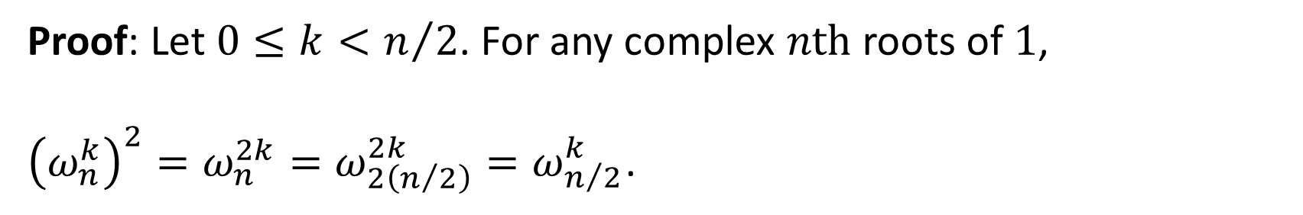
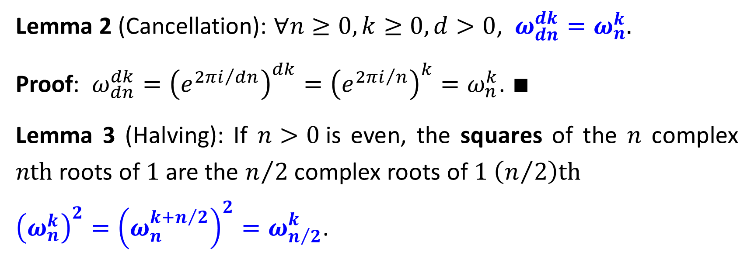
Lemma 2 (Cancellation): $∀n≥0, k≥0, d>0$, $ω_{dn}^{dk}=ω_{n}^{k}.$
Proof: $ω_{dn}^{dk}={\left(e^{{2πi}/{dn}}\right)}^{dk}={\left(e^{{2πi}/n}\right)}^{k}=ω_{n}^{k}$. $∎$
Lemma 3 (Halving): If $n>0$is even, the squares of the $n$ complex $n\text{th}$ roots of $1$ are the $n/2$ complex roots of $1$ $\left(n/2\right)\text{th}$
${\left(ω_{n}^{k}\right)}^{2}={\left(ω_{n}^{k+n/2}\right)}^{2}=ω_{n/2}^{k}$.
Proof: Let $0≤k<n/2$. For any complex $n\text{th}$ roots of $1$,
${\left(ω_{n}^{k}\right)}^{2}=ω_{n}^{2k}=ω_{2\left(n/2\right)}^{2k}=ω_{n/2}^{k}$.
lemma 2

Slide 15
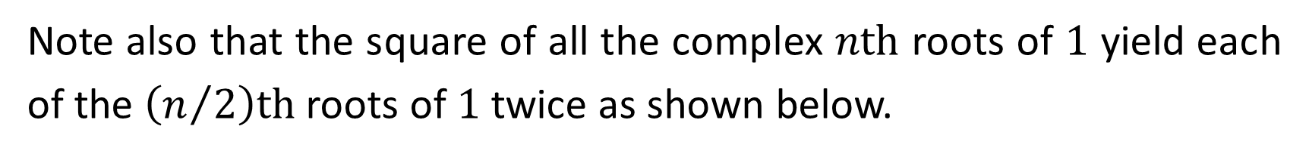
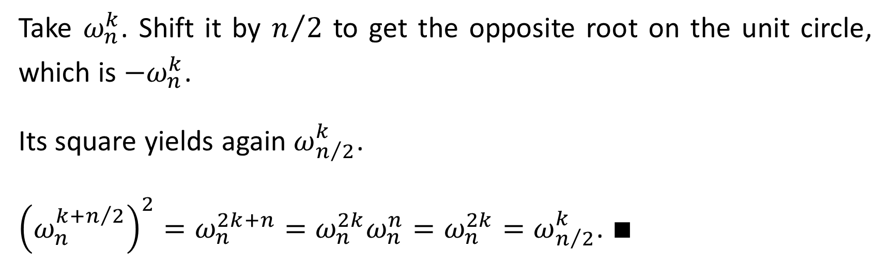
Note also that the square of all the complex $n\text{th}$ roots of $1$ yield each of the $\left(n/2\right)\text{th}$ roots of $1$ twice as shown below.
Take $ω_{n}^{k}$. Shift it by $n/2$ to get the opposite root on the unit circle, which is ${−ω}_{n}^{k}$.
Its square yields again $ω_{n/2}^{k}$.
${\left(ω_{n}^{k+n/2}\right)}^{2}=ω_{n}^{2k+n}=ω_{n}^{2k}ω_{n}^{n}=ω_{n}^{2k}=ω_{n/2}^{k}$. $∎$
lemma 2

Slide 16
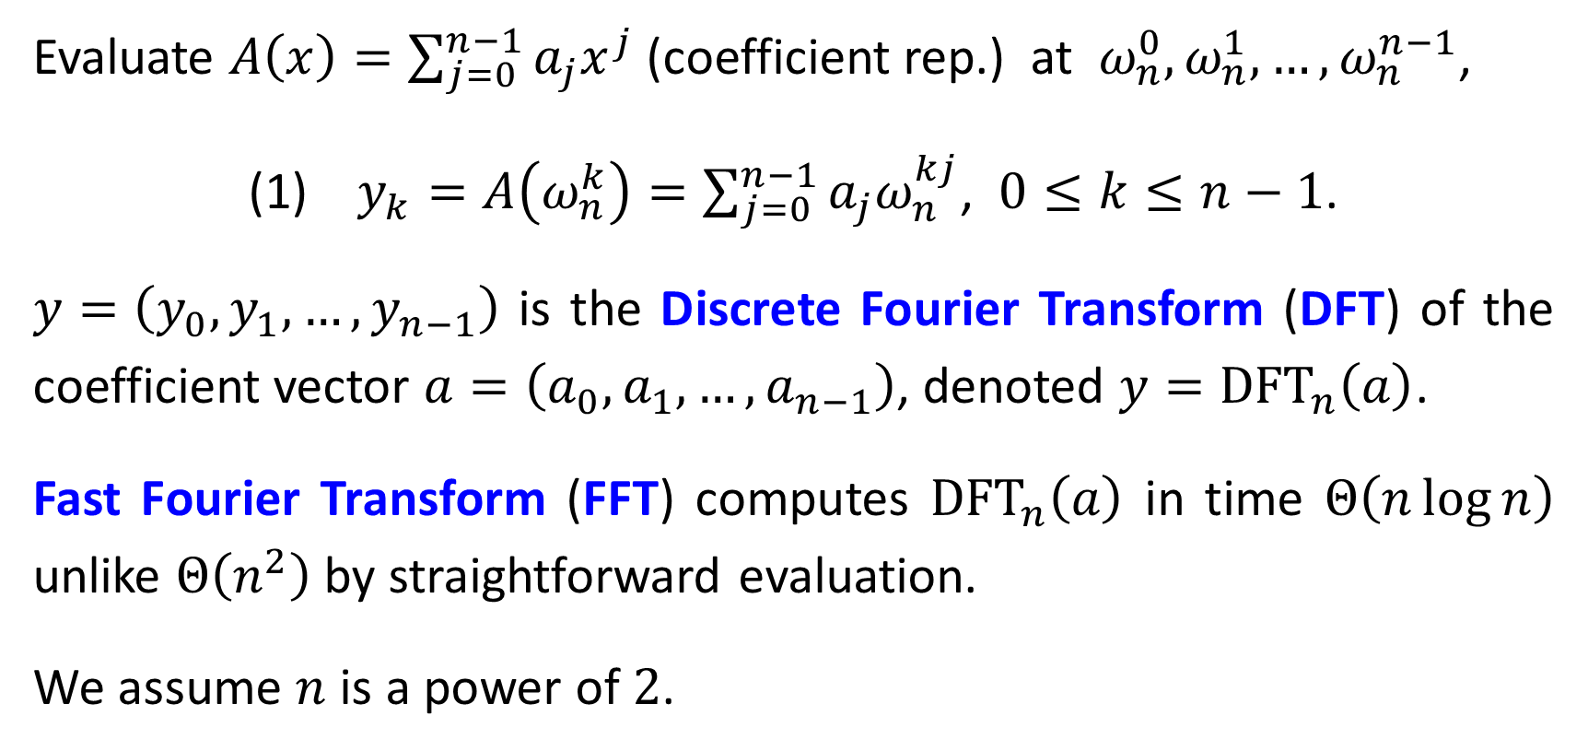
DFT and FFT
Evaluate $A\left(x\right)=\sum_{j=0}^{n−1}{a_{j}x^{j}}$ (coefficient rep.) at $ω_{n}^{0},ω_{n}^{1},…,ω_{n}^{n−1}$,
(1) $y_{k}=A\left(ω_{n}^{k}\right)=\sum_{j=0}^{n−1}{a_{j}ω_{n}^{kj}}$, $0≤k≤n−1$.
$y=\left(y_{0},y_{1},…,y_{n−1}\right)$ is the Discrete Fourier Transform (DFT) of the coefficient vector $a=\left(a_{0},a_{1},…,a_{n−1}\right)$, denoted $y={\text{DFT}}_{n}\left(a\right)$.
Fast Fourier Transform (FFT) computes ${\text{DFT}}_{n}\left(a\right)$ in time $Θ\left(n\log{n}\right)$ unlike $Θ\left(n^{2}\right)$ by straightforward evaluation.
We assume $n$ is a power of $2$.

Slide 17
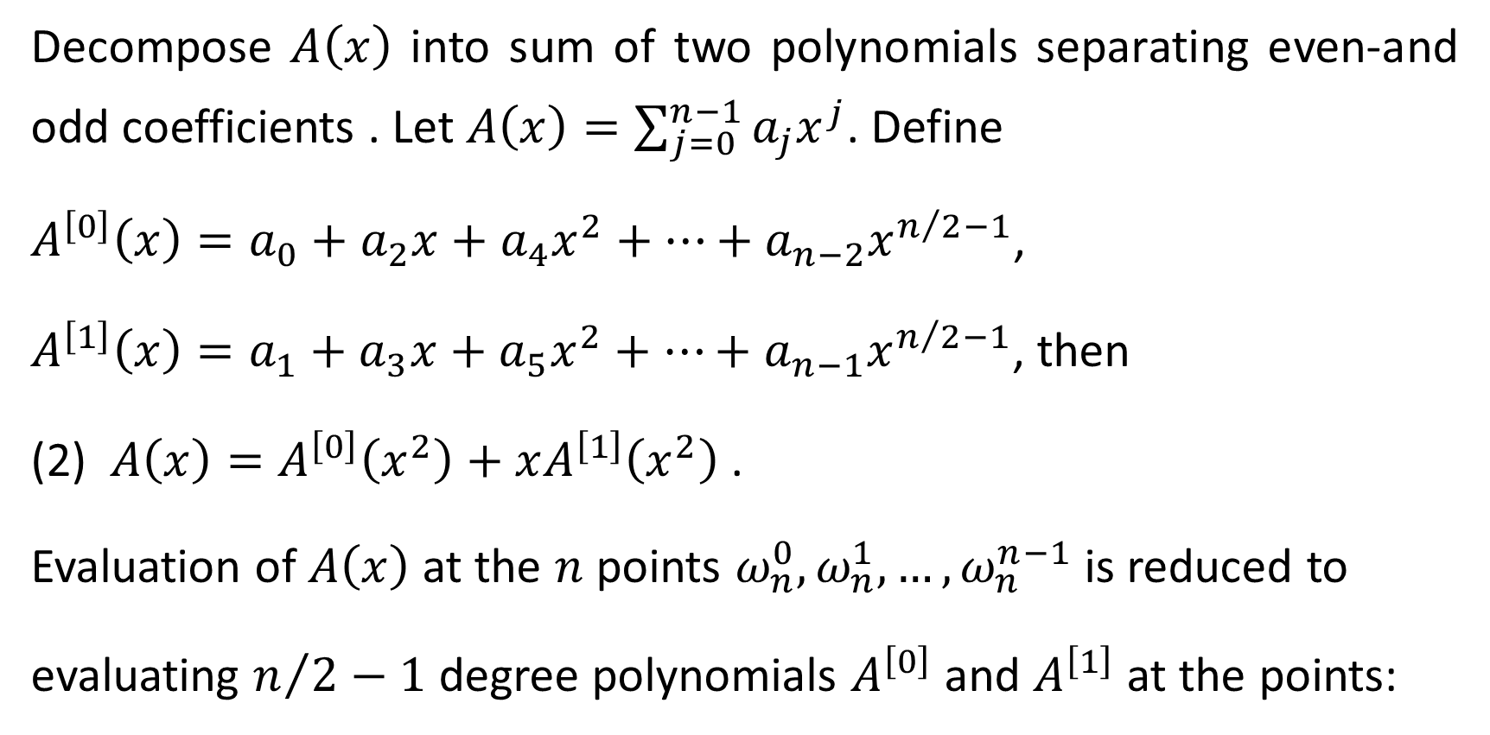
Decompose $A\left(x\right)$ into sum of two polynomials separating even-and odd coefficients . Let $A\left(x\right)=\sum_{j=0}^{n−1}{a_{j}x^{j}}$. Define
$A^{\left[0\right]}\left(x\right)=a_{0}+a_{2}x+a_{4}x^{2}+⋯+a_{n−2}x^{n/2−1}$,
$A^{\left[1\right]}\left(x\right)=a_{1}+a_{3}x+a_{5}x^{2}+⋯+a_{n−1}x^{n/2−1}$, then
(2) $A\left(x\right)=A^{\left[0\right]}\left(x^{2}\right)+xA^{\left[1\right]}\left(x^{2}\right)$ .
Evaluation of $A\left(x\right)$ at the $n$ points $ω_{n}^{0},ω_{n}^{1},…,ω_{n}^{n−1}$ is reduced to
evaluating $n/2−1$ degree polynomials $A^{\left[0\right]}$ and $A^{\left[1\right]}$ at the points:

Slide 18
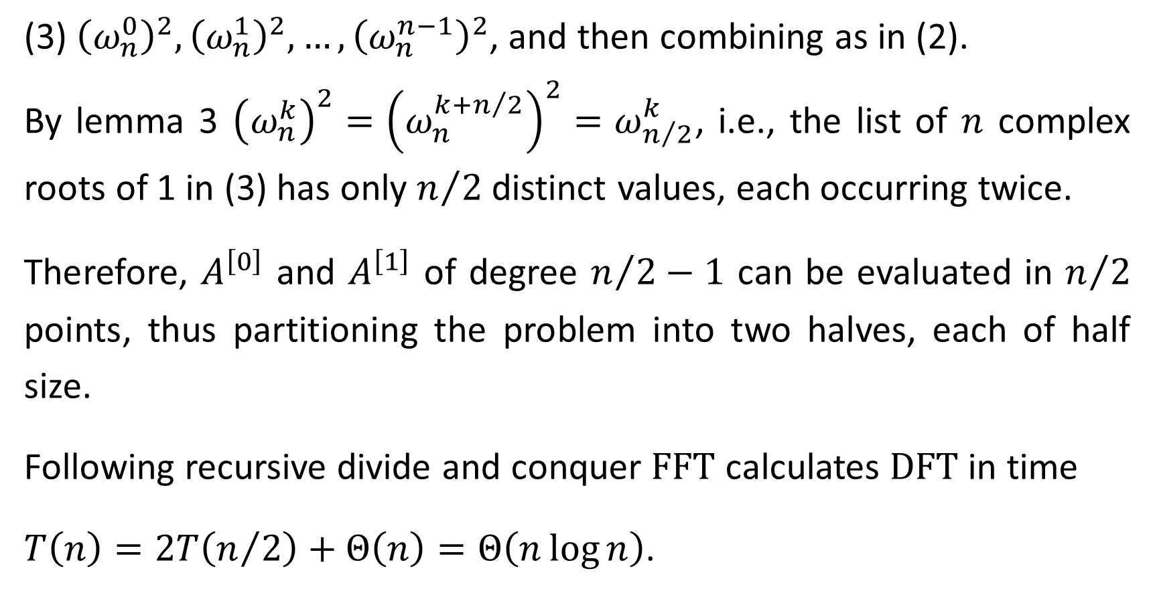
(3) ${\left(ω_{n}^{0}\right)}^{2},{\left(ω_{n}^{1}\right)}^{2},…,{\left(ω_{n}^{n−1}\right)}^{2}$, and then combining as in (2).
By lemma 3 ${\left(ω_{n}^{k}\right)}^{2}={\left(ω_{n}^{k+n/2}\right)}^{2}=ω_{n/2}^{k}$, i.e., the list of $n$ complex roots of 1 in (3) has only $n/2$ distinct values, each occurring twice.
Therefore, $A^{\left[0\right]}$ and $A^{\left[1\right]}$ of degree $n/2−1$ can be evaluated in $n/2$ points, thus partitioning the problem into two halves, each of half size.
Following recursive divide and conquer $\text{FFT}$ calculates $\text{DFT}$ in time
$T\left(n\right)=2T\left(n/2\right)+Θ\left(n\right)=Θ\left(n\log{n}\right)$.

Slide 19
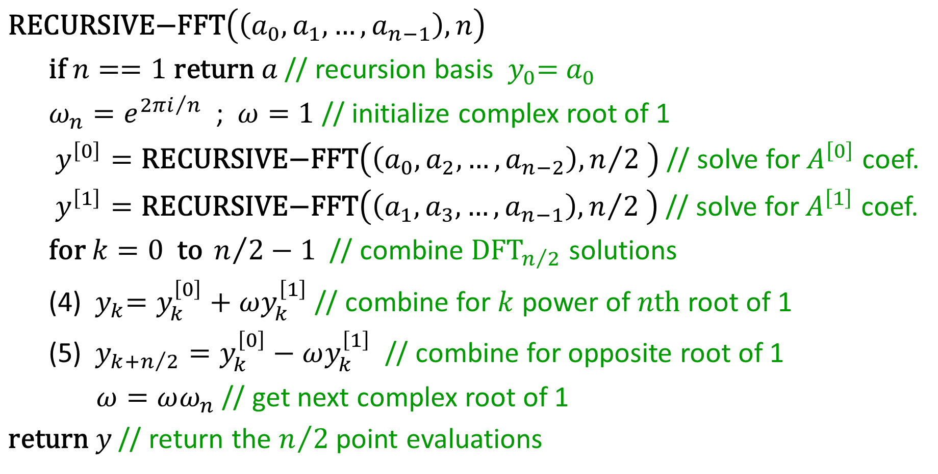
$\text{RECURSIVE}\text{−}\text{FFT}\left(\left(a_{0},a_{1}, …,a_{n−1}\right),n\right)$
$\text{if} n==1 \text{return} a$ // recursion basis ${ y}_{0}={ a}_{0}$
$ω_{n}=e^{{2πi}/n}$ ; $ω=1$ // initialize complex root of 1
$y^{\left[0\right]}=\text{RECURSIVE}\text{−}\text{FFT}\left(\left(a_{0},a_{2}, …,a_{n−2}\right),n/2 \right)$ // solve for $A^{\left[0\right]}$ coef.
$y^{\left[1\right]}=\text{RECURSIVE}\text{−}\text{FFT}\left(\left(a_{1},a_{3}, …,a_{n−1}\right),n/2 \right)$ // solve for $A^{\left[1\right]}$ coef.
$\text{for} k=0 \text{to} n/2−1$ // combine ${\text{DFT}}_{n/2}$ solutions
(4) ${ y}_{k}=y_{k}^{\left[0\right]}+ωy_{k}^{\left[1\right]}$ // combine for $k$ power of $n\text{th}$ root of 1
(5) $y_{k+n/2}=y_{k}^{\left[0\right]}−ωy_{k}^{\left[1\right]}$ // combine for opposite root of 1
$ω=ωω_{n}$ // get next complex root of 1
$\text{return} y$ // return the $n/2$ point evaluations

Slide 20
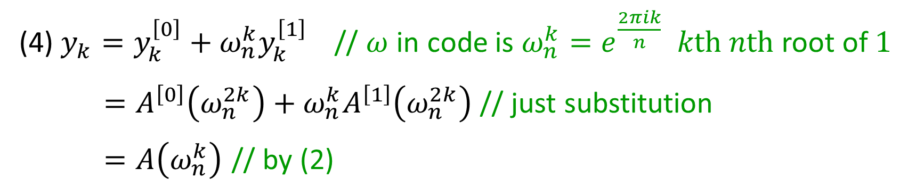
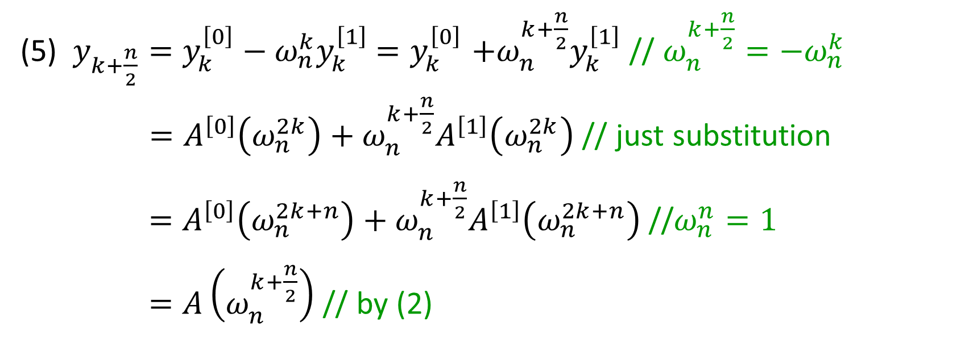
(4) $y_{k}=y_{k}^{\left[0\right]}+ω_{n}^{k}y_{k}^{\left[1\right]}$ // $ω$ in code is $ω_{n}^{k}=e^{\frac{2πik}{n}}$ $k\text{th}$ $n\text{th}$ root of $1$
$=A^{\left[0\right]}\left(ω_{n}^{2k}\right)+ω_{n}^{k}A^{\left[1\right]}\left(ω_{n}^{2k}\right)$ // just substitution
$=A\left(ω_{n}^{k}\right)$ // by (2)
(5) $y_{k+\frac{n}{2}}=y_{k}^{\left[0\right]}−ω_{n}^{k}y_{k}^{\left[1\right]}$ ${=y}_{k}^{\left[0\right]}+ω_{n}^{k+\frac{n}{2}}y_{k}^{\left[1\right]}$ // $ω_{n}^{k+\frac{n}{2}}=−ω_{n}^{k}$
$=A^{\left[0\right]}\left(ω_{n}^{2k}\right)+ω_{n}^{k+\frac{n}{2}}A^{\left[1\right]}\left(ω_{n}^{2k}\right)$ // just substitution
$=A^{\left[0\right]}\left(ω_{n}^{2k+n}\right)+ω_{n}^{k+\frac{n}{2}}A^{\left[1\right]}\left(ω_{n}^{2k+n}\right)$ //$ω_{n}^{n}=1$
$=A\left(ω_{n}^{k+\frac{n}{2}}\right)$ // by (2)

Slide 21
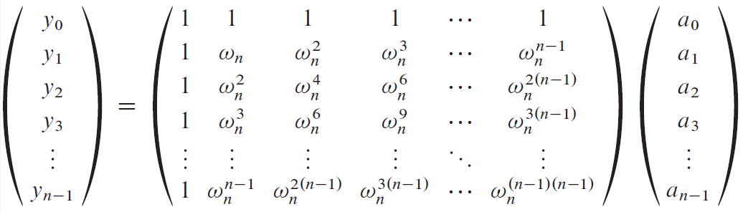
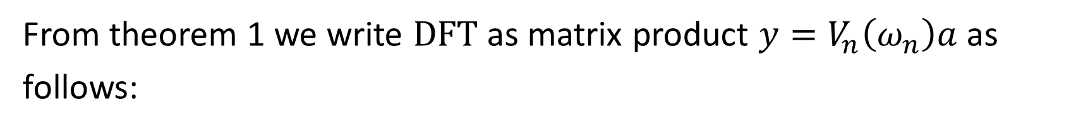
Interpolation at the Complex Roots of 1
From theorem 1 we write $\text{DFT}$ as matrix product $y=V_{n}\left(ω_{n}\right)a$ as follows:
$a={\text{DFT}}_{n}^{−1}\left(y\right)$ is obtained by efficient calculation of $V_{n}^{−1}$.

Slide 22
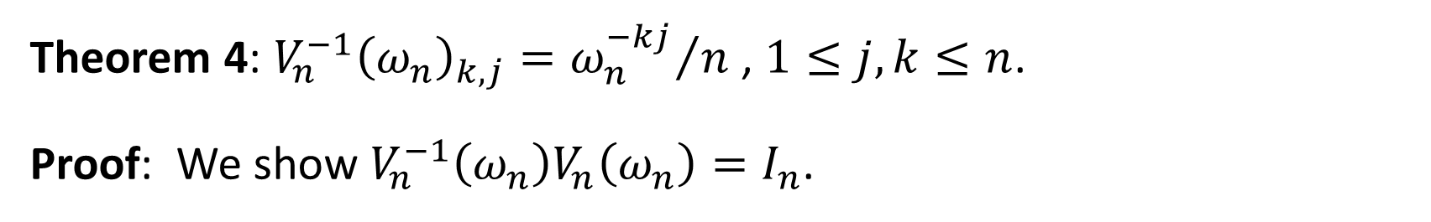
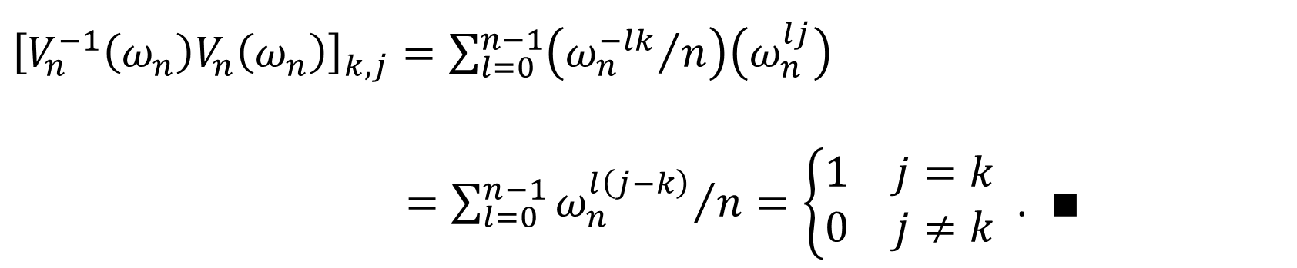
Theorem 4: ${V_{n}^{−1}\left(ω_{n}\right)}_{k,j}={ω_{n}^{−kj}}/n$ , $1≤j,k≤n$.
Proof: We show $V_{n}^{−1}\left(ω_{n}\right)V_{n}\left(ω_{n}\right)=I_{n}$.
${\left[V_{n}^{−1}\left(ω_{n}\right)V_{n}\left(ω_{n}\right)\right]}_{k,j}=\sum_{l=0}^{n−1}{\left({ω_{n}^{−lk}}/n\right)\left(ω_{n}^{lj}\right)}$
$=\sum_{l=0}^{n−1}{{ω_{n}^{l\left(j−k\right)}}/n}=\left\{\begin{matrix}1 & j=k \\ 0 & j≠k\end{matrix}\right.$ . $∎$
Sum of all 1’s roots equals 0
$\sum_{l=0}^{n−1}{ω_{n}^{l\left(j−k\right)}}=\frac{ω_{n}^{n\left(j−k\right)}−1}{ω_{n}^{\left(j−k\right)}−1}=0$, well defined since $0<\left|j−k \right|<n$.

Slide 23
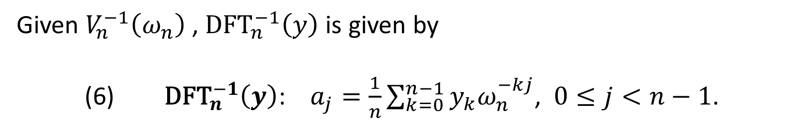
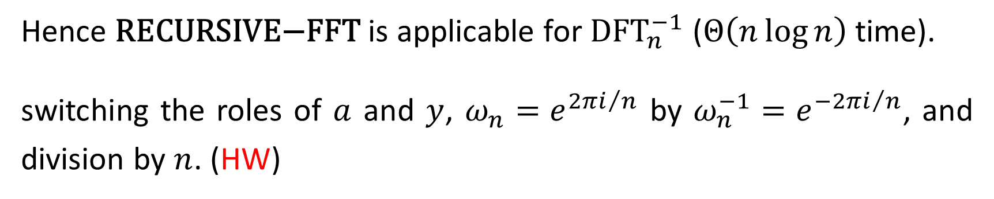
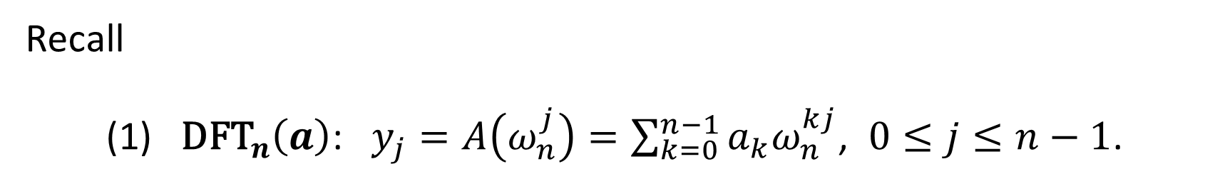
Given $V_{n}^{−1}\left(ω_{n}\right)$ , ${\text{DFT}}_{n}^{−1}\left(y\right)$ is given by
(6) ${\text{DFT}}_{n}^{−1}\left(y\right)$: $a_{j}=\frac{1}{n}\sum_{k=0}^{n−1}{y_{k}ω_{n}^{−kj}}$, $0≤j<n−1$.
Recall
(1) ${\text{DFT}}_{n}\left(a\right)$: $y_{j}=A\left(ω_{n}^{j}\right)=\sum_{k=0}^{n−1}{a_{k}ω_{n}^{kj}}$, $0≤j≤n−1$.
Hence $\text{RECURSIVE}\text{−}\text{FFT}$ is applicable for ${\text{DFT}}_{n}^{−1}$ ($Θ\left(n\log{n}\right)$ time).
switching the roles of $a$ and $y$, $ω_{n}=e^{{2πi}/n}$ by $ω_{n}^{−1}=e^{{−2πi}/n}$, and division by $n$. (HW)

Slide 24
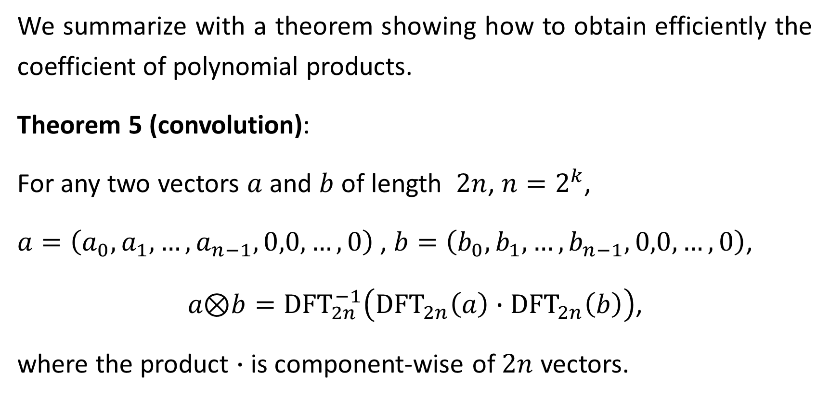
We summarize with a theorem showing how to obtain efficiently the coefficient of polynomial products.
Theorem 5 (convolution):
For any two vectors $a$ and $b$ of length $2n$, $n=2^{k}$,
$a=\left(a_{0},a_{1},…,a_{n−1},0,0,…,0\right)$ , $b=\left(b_{0},b_{1},…,b_{n−1},0,0,…,0\right)$,
$a\text{⊗}b={\text{DFT}}_{2n}^{−1}\left({\text{DFT}}_{2n}\left(a\right)∙{\text{DFT}}_{2n}\left(b\right)\right)$,
where the product $∙$ is component-wise of $2n$ vectors.

